Slide 1

Number System Conversion

Slide 2


Different Conversions
Conversion between Binary & Decimal.
Conversion between Decimal & Hexadecimal.
Conversion between Hexadecimal & Binary.
Conversion between Decimal & Octal.
Conversion between Octal & Hexadecimal.
Conversion between Binary & Octal.

Slide 3
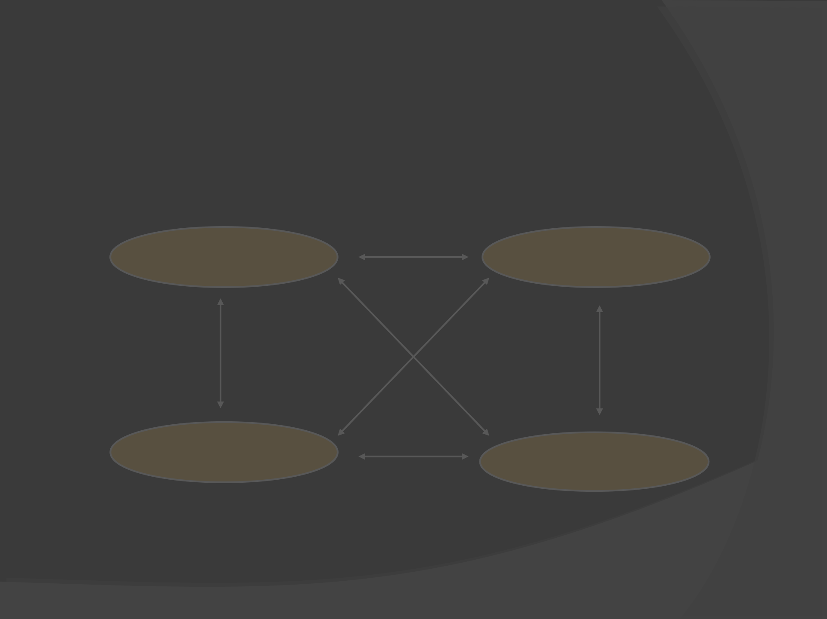
Conversion Among Bases
The possibilities:
Decimal
Octal
Binary
Hexadecimal

Slide 4
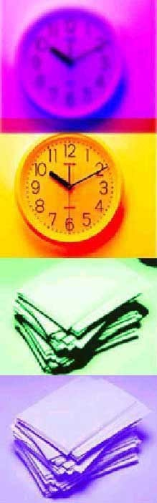
Common Number Systems
System
Bas Symbols e
Decima l | 10 | 0, 1, … 9
Binary | 2 | 0, 1
Octal | 8 | 0, 1, … 7
Hexade cimal | 16 | 0, 1, … 9,
 |  | A, B, … F

Slide 5
Binary to Decimal
Decimal
Octal
Binary
Hexadecimal

Slide 6
Binary to Decimal
Technique
–Multiply each bit by 2^{n}, where n is the “weight” of the bit.
–The weight is the position of the bit, starting from 0 on the right.
–Add the results.

Slide 7
EXAMPLE
Bit “0”
(101011)₂
=> 1 x 2⁰ =
1 x 2¹ =
0 x 2² = 0
1 x 2³ = 8
0 x 2⁴ =
1 x 2⁵
1
2
0
= 32
(43)₁₀

Slide 8


Decimal to Binary
Decimal
Octal
Binary
Hexadecimal

Slide 9
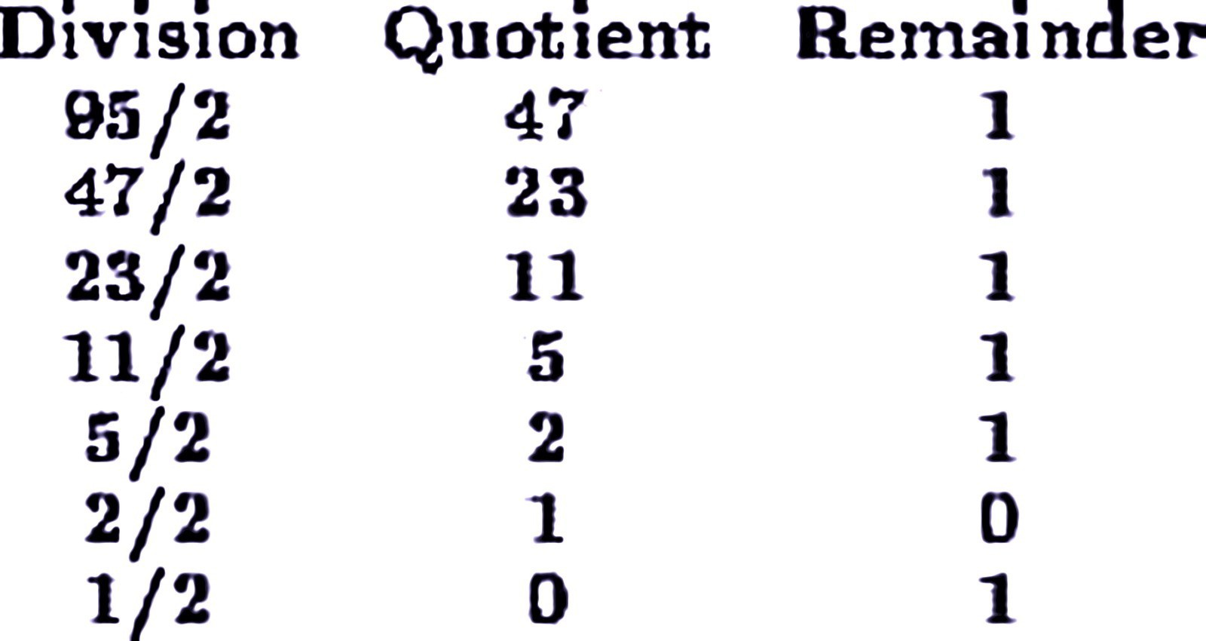


Example

Slide 10
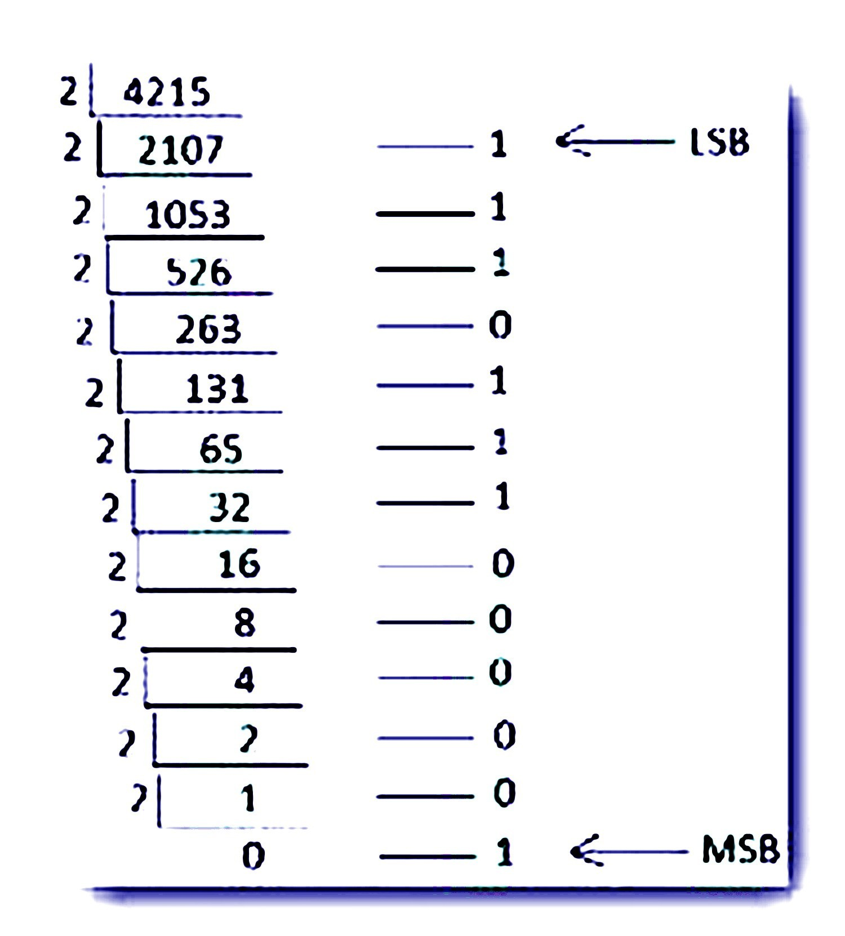
Example

Slide 11

Hexadecimal to Binary
Decimal
Octal
Binary
Hexadecimal

Slide 12
Hexadecimal to Binary
Technique
Convert each hexadecimal digit to a 4-bit equivalent binary representation

Slide 13


Example
10AF₁₆ = ?₂
1
0
A
F
0001 0000 1010 1111
10AF₁₆ = 0001000010101111₂

Slide 14
Binary to Hexadecimal
Decimal
Octal
Binary
Hexadecimal

Slide 15

· Technique
› Group bits in fours, starting on right
› Convert to hexadecimal digits

Slide 16

1010111011₂ = ?₁₆
10 1011 1011
2 B
B
1010111011₂ = 2BB₁₆

Slide 17

Octal to Decimal
Decimal
Octal
Binary
Hexadecimal

Slide 18


Octal to Decimal
Technique
Multiply each bit by 8^{n}, where n is the “weight” of the bit.
The weight is the position of the bit, starting from 0 on the right.
Add the results

Slide 19


₈0
₈1
₈2
(468)₁₀
724₈ | =>4 | x
 | 2 | x
 | 7 | x
= | 4
= | 16
= | 448

Slide 20
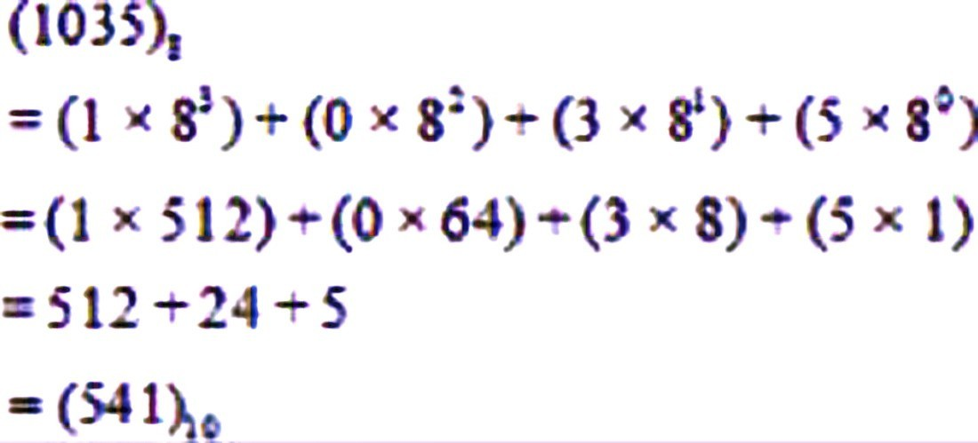
Example

Slide 21
Decimal to Octal
Decimal
Octal
Binary
Hexadecimal

Slide 22
Decimal to Octal
Technique
Divide by 8
Keep track of the remainder

Slide 23
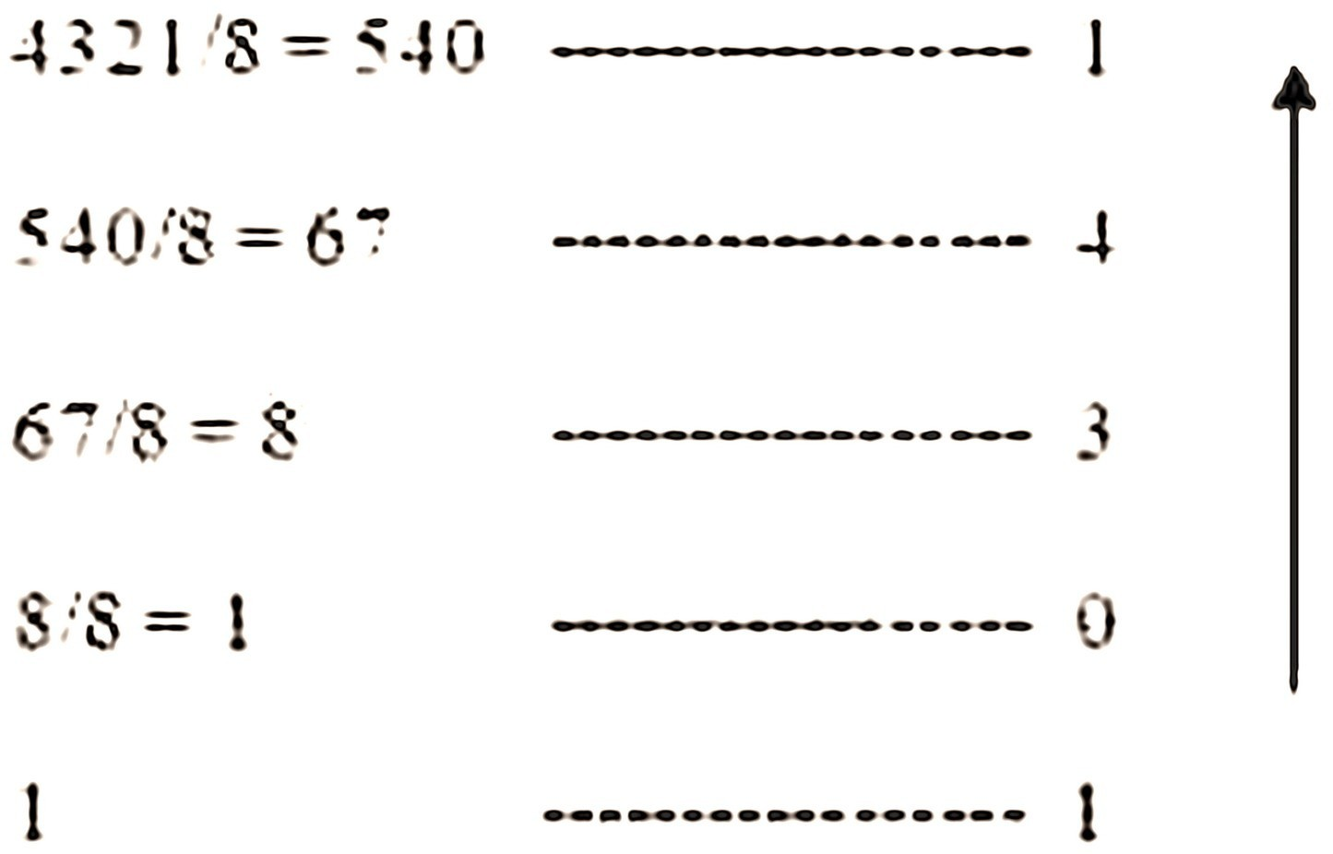
Example

Slide 24

Decimal
Octal
Binary
Hexadecimal

Slide 25

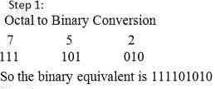

Slide 26
Binary to Octal
Decimal
Octal
Binary
Hexadecimal

Slide 27
Binary to Octal
Technique
Group bits in threes, starting on right
Convert to octal digits

Slide 28
Example
1011010111₂ = ?₈
1 011 010 111
1 3 2 7
1011010111₂ = 1327₈

Slide 29



Decimal
Octal
Binary
Hexadecimal

Slide 30

Technique
Multiply each bit by 16^{n}, where n is the “weight” of the bit
The weight is the position of the bit, starting from 0 on the right
Add the results

Slide 31

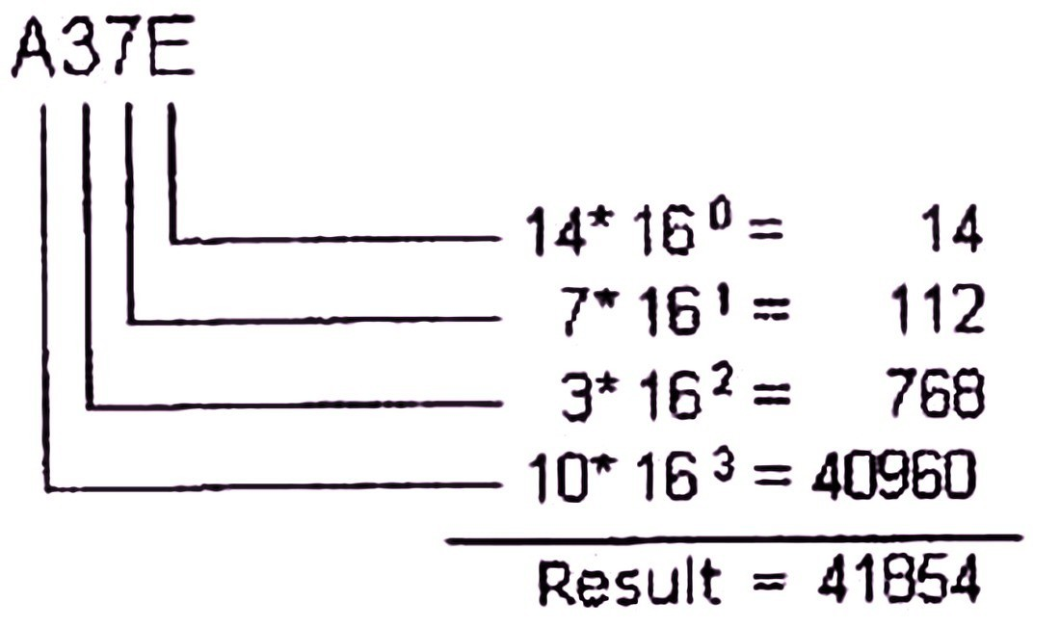

Slide 32
Example
ABC₁₆ | => C | x | 16⁰ | = | 12 | x | 1 | = | 12
 | B | x | 16¹ | = | 11 | x | 16 | = | 176
 | A | x | 16² | = | 10 | x | 256 | = | 2560
2748₁₀

Slide 33


Decimal
Octal
Binary
Hexadecimal

Slide 34

Technique
◻
Divide by 16
Keep track of the remainder

Slide 35
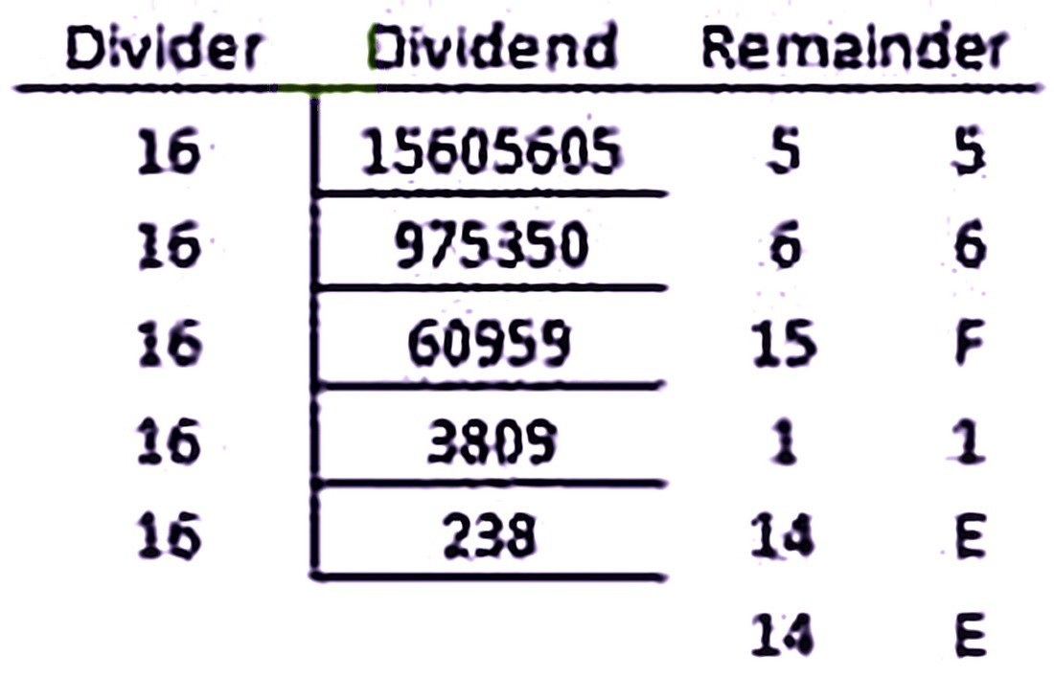

Slide 36

Decimal
Octal
Binary
Hexadecimal

Slide 37

Technique
Use binary as an intermediary

Slide 38

1076₈ =
?16
1 | 0 |  | 7 | 6
001 | 000 |  | 111 | 110
2 |  | 3 |  | E | 1076₈ | = | 23E₁₆

Slide 39

Decimal
Octal
Binary
Hexadecimal

Slide 40

Technique
Use binary as an intermediary

Slide 41

1F0C₁₆ = ?₈
1
F
0
C
0001 1111 0000 1100
1 7 4
1
4
1F0C₁₆ = 17414₈

